Slide 1
TART Interferometer Imaging Pipeline
Jason Jackson
Supervisor: Dr. TL Grobler

Slide 2
Contents
What is an interferometer
How does an imaging pipeline work
TART
The Pipeline

Slide 3
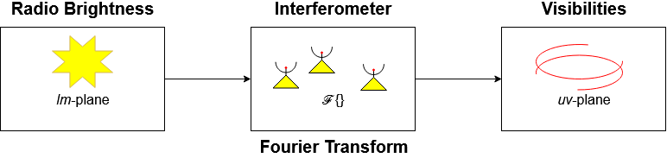
What is radio interferometry
A radio interferometer samples the Fourier transform of the sky brightness distribution. This Fourier transform is called visibilities.

Slide 4
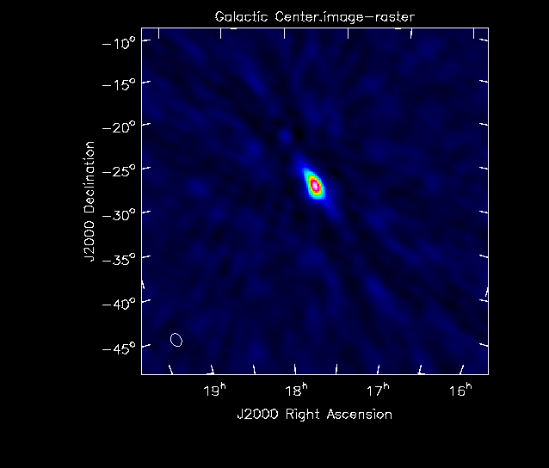
How does an imaging pipeline work
A radio interferometer samples the visibilities which are a Fourier transform, and as we know, a Fourier transform can be inverted. So if we apply an inverse Fourier transform onto the visibilities, then we should get the sky brightness distribution as an output. We can simply plot this and have an image as the interferometer sees the sky.

Slide 5
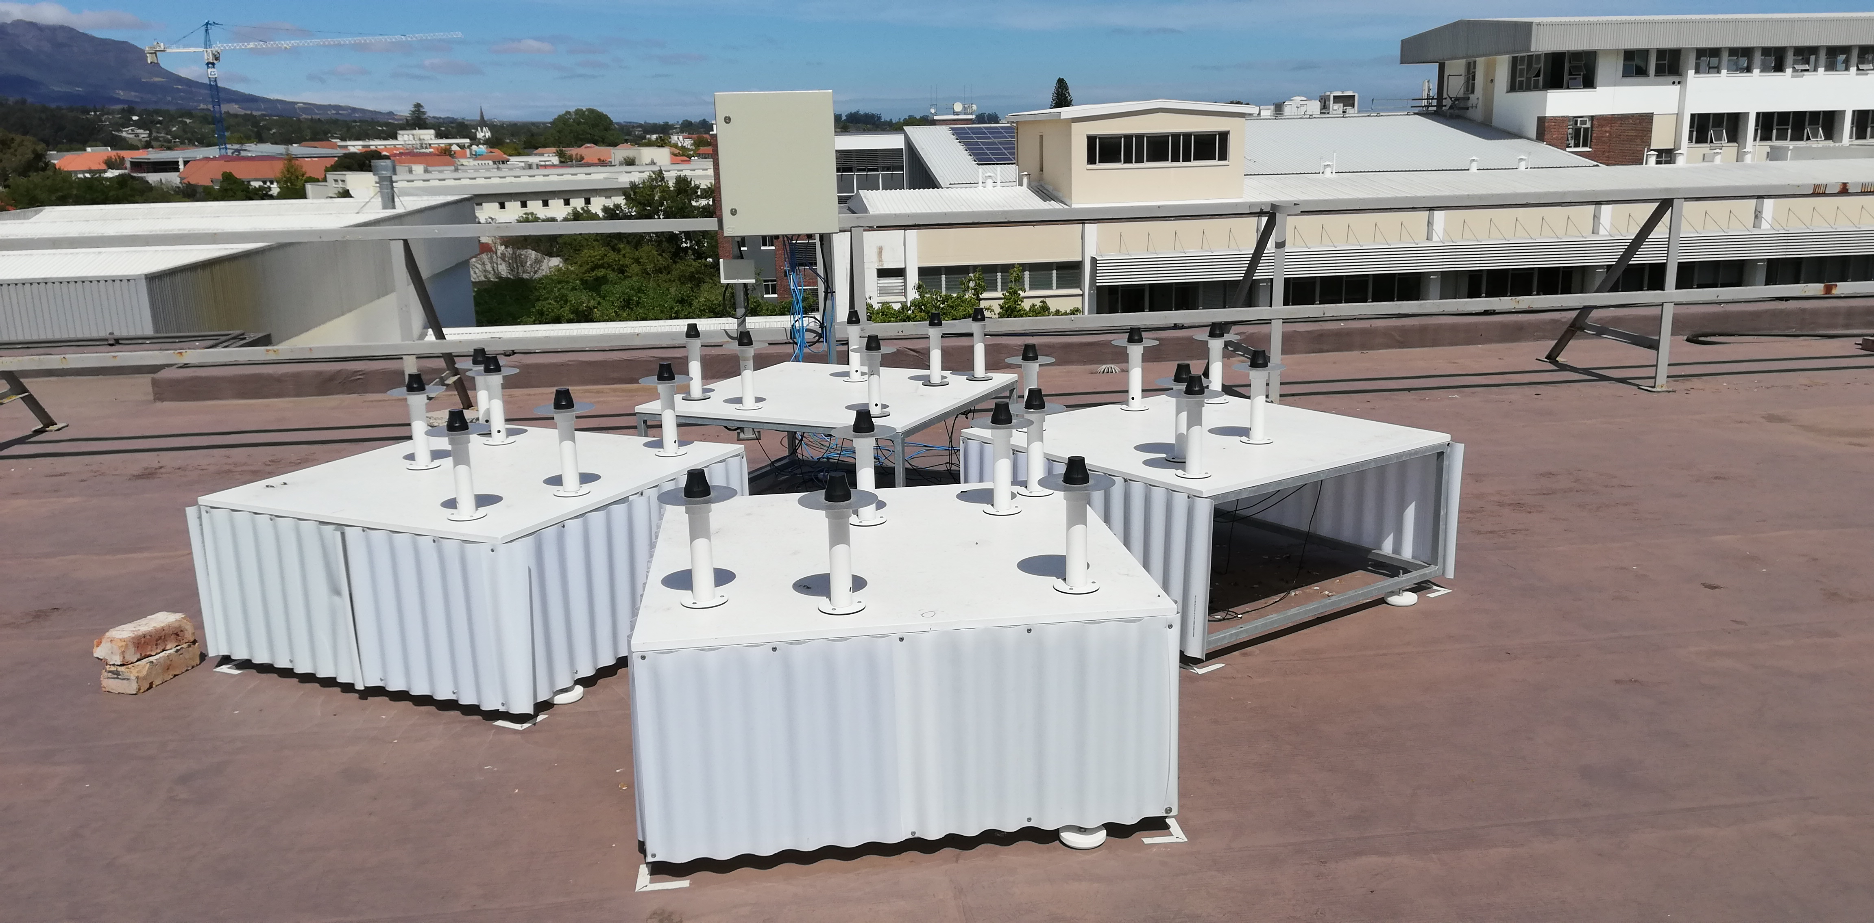
TART
The TART radio interferometer samples the visibilities which are a Fourier transform, and as we know, a Fourier transform can be inverted. So if we apply an inverse Fourier transform onto the visibilities, then we should get the sky brightness distribution as an output. We can simply plot this and have an image as the interferometer sees the sky.

Slide 6
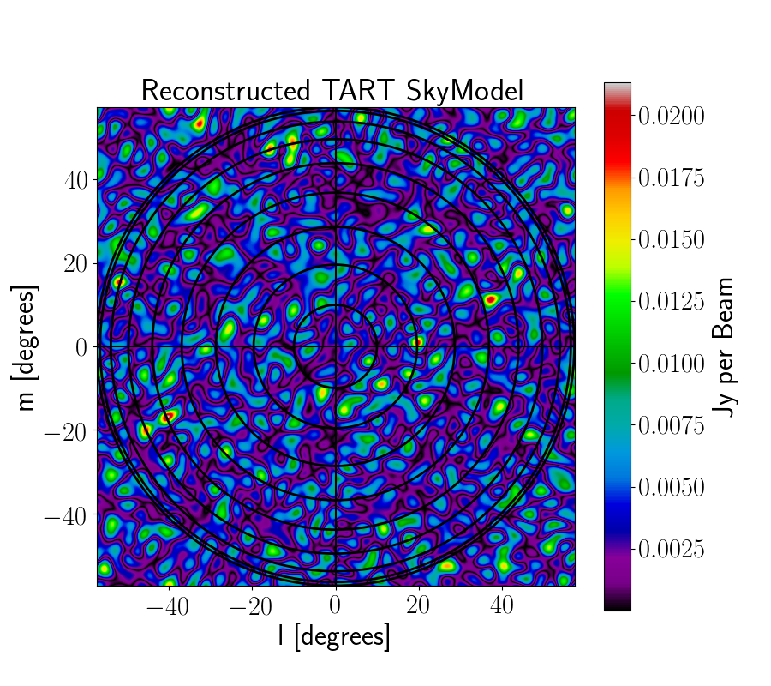
The pipeline
This pipeline connects to TART’s API and uses the visibilites it receives, which are live readings, to create images of the sky at the time of observation.
The pipeline takes all the visibilities and adds them to a 2 dimensional grid. This grid then has a inverse Fourier Transform applied to it, which creates an image.

Slide 7
Questions
GIF

